Slide 1
The Comparison of Sensor Technologies
Study Case : Smart Parking
Aprilia, Bamiduro, Rupanya
Notes:
Mercy

Slide 2
What we gonna talk about today
01
Why we take smart parking as the focus?
3 - 4
02
How Smart Parking Works?
5 - 6
03
IoT base on Outdoor parking space
7 - 11
Technologies in Smart Parking System
04
9 - 26
13 - 31
05
Challenges of Outdoor Smart Parking
33
06
Summary
34
Notes:
Mercy

Slide 3
Why we take smart parking as the focus?
1
2
3
4
5
6
Notes:
Mercy
Why Parking IOT important? Increase population -> Increase transportation -> Increase parking space depency Public transport more sustainable for environment, but private vehicles still needed due to convenience -> Driverless sharing car maybe solution, but the tech still far away, IoT-enhanced parking system is more achievable tech for time being
Advantage than traditional : IoT Work smarter and easier. - Traditional parking systems has difficulties to find the vacant slots -> may cause a lot of traffic, minor collisions and accidents in public

Slide 4

1
1
2
2
3
3
4
4
5
5
6
6
Notes:
Mercy
Why Parking IOT important? Why we need the parking IoT, when the driverless day in horizon? Benefit of IoT parking than traditional approaches

Slide 5
How Smart Parking Works?
1
1
2
2
3
3
4
4
5
5
6
6
Notes:
Mercy

Slide 6
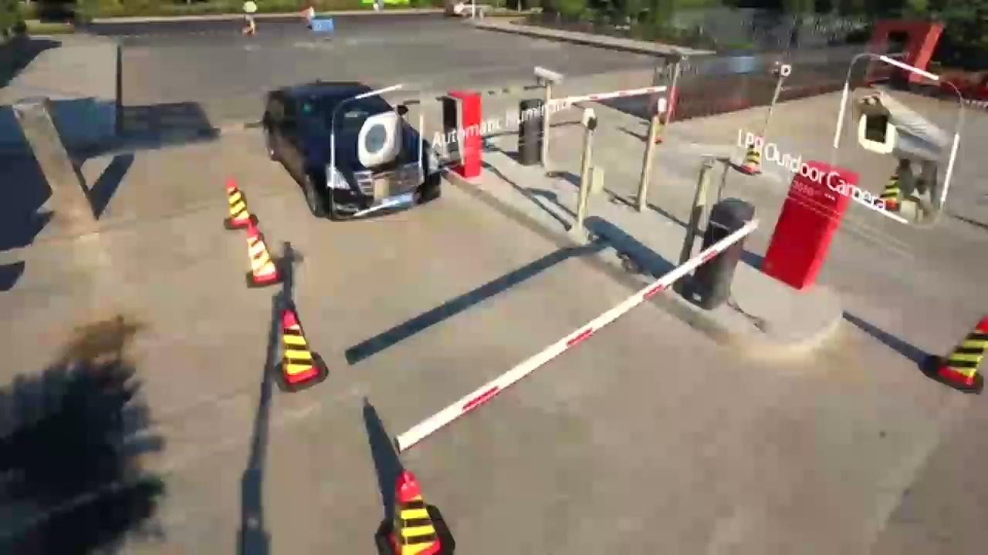
1
1
2
2
3
3
4
4
5
5
6
6
Notes:
Mercy
How it works? 1. Identify the car 2. Finding the empty lot 3. Counting of the payment 4. Recognition the driver

Slide 7
IoT OUTDOOR PARKING SPACE
1
1
2
2
3
3
4
4
5
5
6
6
Notes:
Mercy
-> Why we choose outdoor as point? Because, there are many open parking lots which do not support reservation, freely available for a limited amount of time and are commonly placed outdoors occupying a large amount of space
Outdoor vs Indoor : research gap in order to improve parking efficiency at an open parking lot (Especially, open parking lots which do not support reservation, freely available for a limited amount of time and are commonly placed outdoors occupying a large amount of space.) Paidi, et al. 2018 Challenges in an open parking lot are: freely available where the reservation is not possible and they are subjected to environmental conditions when placed outdoors. Therefore, suitability of sensors and technologies was made by compatibility and expenditure parameters (compatibility is measured in terms of varying environment and lighting conditions while expenditure is measured in terms of purchase cost, installation and maintenance activities.)

Slide 8
Ideal Smart Parking System
01
Easy Installation
Easy Maintenance
02
03
Cost Effective
User Friendly
04
05
Reliable
06
Scalable
07
Unaffected by Environment
Reduce Manpower
08
09
Data collecting
Easy Physical Monitoring
10
“SMART PARKING IN FAST-GROWING CITIES (Chapter 10)
“An IoT based Smart Outdoor Parking System
“Smart parking sensors, technologies and applications for open parking lots: a review
1
1
1
2
2
2
3
3
3
4
4
4
5
5
5
6
6
6
Notes:
Mercy

Slide 9
Important Criterias to choose suitable technology
01
LOCATION & ENVIRONMENT
02
COST
USERS
03
SCALABILITY
04
05
06
INSTALLATION & MAINTENANCE
RELIABILITY
“SMART PARKING IN FAST-GROWING CITIES (Chapter 10)
“An IoT based Smart Outdoor Parking System
“Smart parking sensors, technologies and applications for open parking lots: a review
1
1
1
2
2
2
3
3
3
4
4
4
5
5
5
6
6
6
Notes:
Mercy

Slide 10
Technologies
01
WSC
Infrared
05
02
GPS
Load Cells
06
03
Bluetooth Beacons
Ultrasonic
07
04
Inductive Loop Detector
Magnetometer
08
1
1
2
2
3
3
4
4
5
5
6
6
Notes:
Mercy

Slide 11
Technologies
09
RFID
13
Microwave Radar
10
Contact Sensors
Vehicular Ad-Hoc Networks
14
11
Visible Light Sensor
Crowdsourcing
15
12
Machine Vision
1
1
2
2
3
3
4
4
5
5
6
6
Notes:
Mercy

Slide 12
Where we are?
01
Why we take smart parking as the focus?
3 - 4
02
How Smart Parking Works?
5 - 6
03
IoT base on Outdoor parking space
7 - 11
Technologies in Smart Parking System
04
9 - 26
13 - 31
Notes:
Mercy

Slide 13
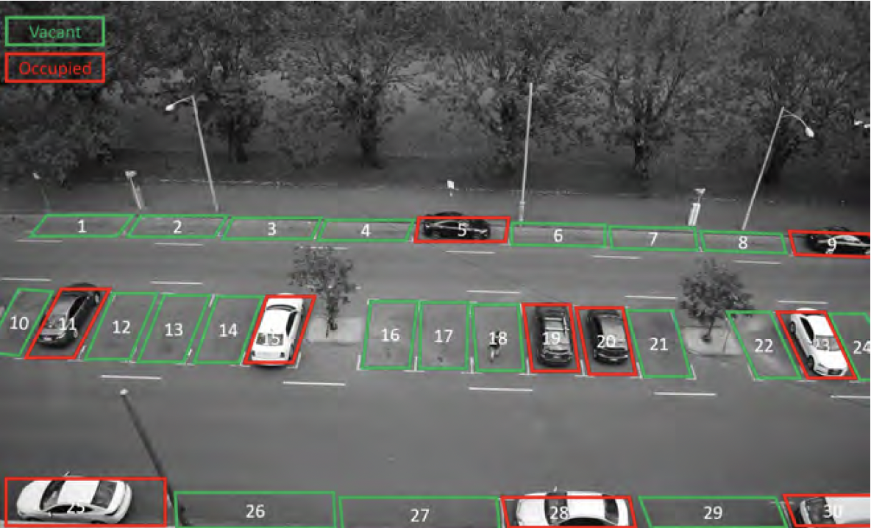
01
Is a wireless live camera built with an embedded unit for visual representation and image processing of the parking area.
WSC
1
1
2
2
3
3
4
4
5
5
6
6
Notes:
Smart WSC is a wireless live camera built with an embedded unit for visual representation and image processing of the parking area.
Benefit :WSC is low cost and wireless Negative : requires high maintenance and monitoring of parking areas through WSC

Slide 14
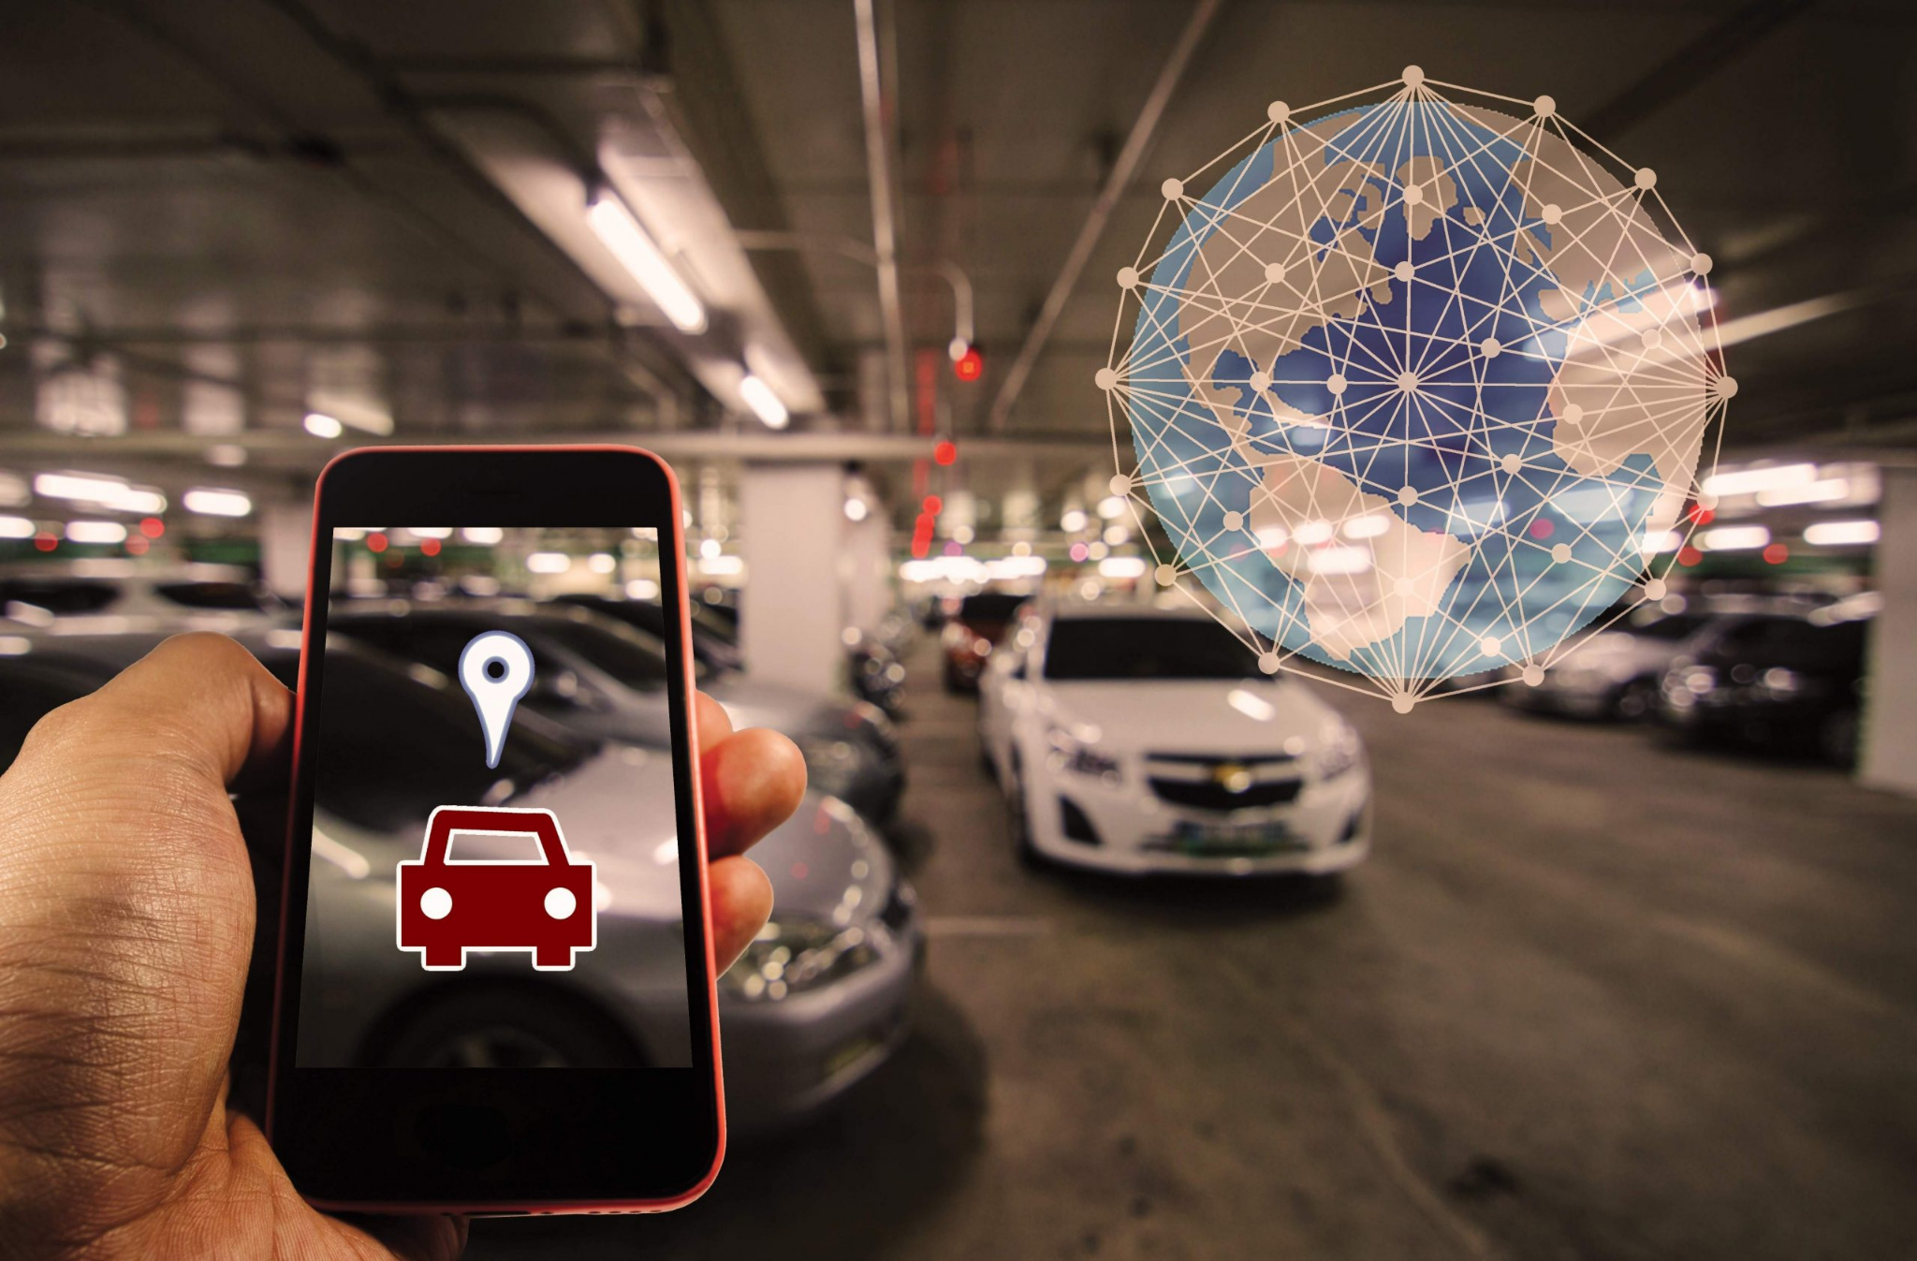
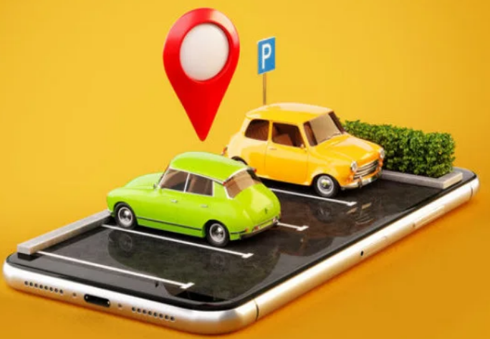
GPS
02
The Global Positioning System (GPS) is a U.S.-owned utility that provides users with positioning, navigation, and timing (PNT) services. The 'traditional' approach of modern IoT
1
1
1
2
2
2
3
3
3
4
4
4
5
5
5
6
6
6
Notes:
Smart - GPS : 'traditional' approach of modern IoT
Negative :
- slow down the whole system
- week signal can cause inaccurate location detected

Slide 15
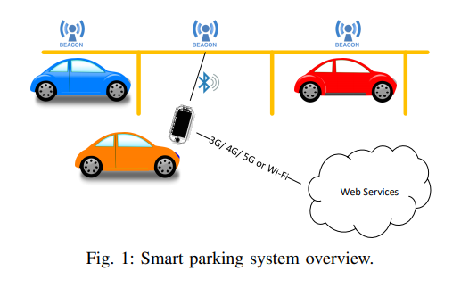
Bluetooth beacons are hardware transmitters — a class of Bluetooth Low Energy devices that broadcast their identifier to nearby portable electronic devices. The technology enables receiver devices to perform actions when in close proximity to a beacon
03
Bluetooth Beacons
1
1
1
2
2
2
3
3
3
4
4
4
5
5
5
6
6
6
Notes:
Smart Bluetooth beacons are hardware transmitters — a class of Bluetooth Low Energy devices that broadcast their identifier to nearby portable electronic devices.
The technology enables receiver devices to perform actions when in close proximity to a beacon
Negative : Wireless approach in general are more vunerable in the terms f security than physical sensors

Slide 16
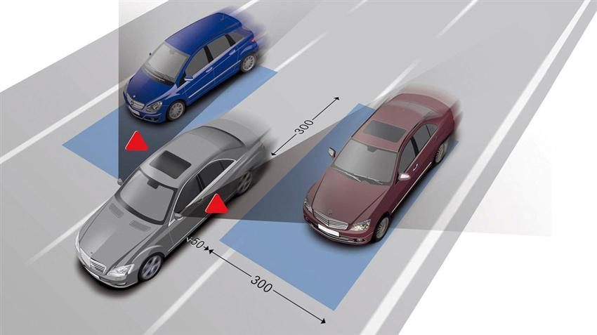
04
Microwave Radar
A microwave radar transmits microwave beam and based on the reflected signal it estimates the velocity of the moving target.
1
1
1
2
2
2
3
3
3
4
4
4
5
5
5
6
6
6
Notes:
Smart
A microwave radar transmits microwave beam and based on the reflected signal it estimates the velocity of the moving target.

Slide 17
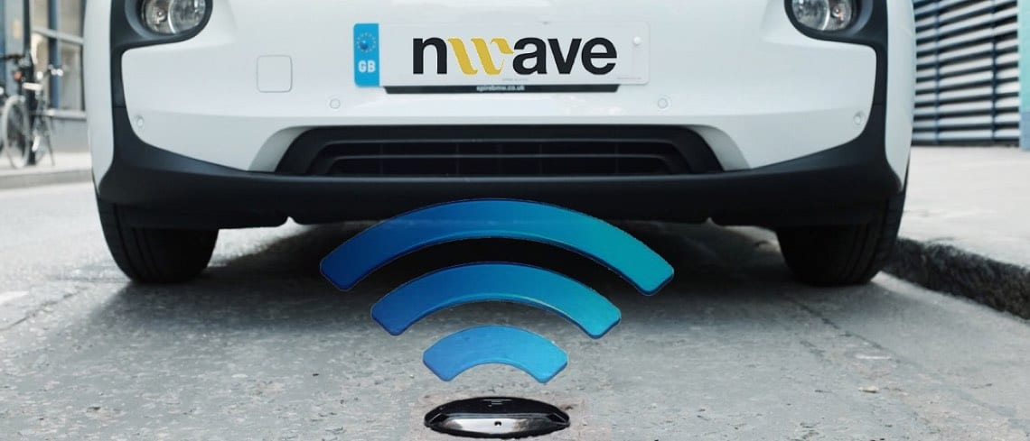
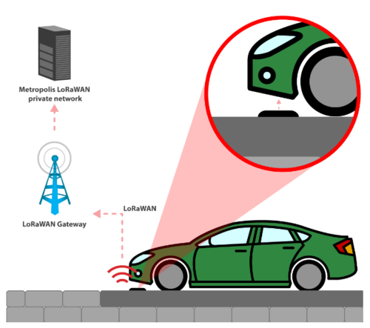
Contact Sensors
05
These sensors generate a signal when they come in contact with a vehicle’s tires.
1
1
1
2
2
2
3
3
3
4
4
4
5
5
5
6
6
6
Notes:
Smart
Contact Sensors generate a signal when they come in contact with a vehicle’s tires. How the sensor percepts the signal defer for every type of this sensor (pneumatic road tubes, inductive loop detectors, and piezoelectric sensors).
Piezoelectric sessors can predict the class of the vehicle, but they are known to be sensitive to the temperature of the ground surface
Benefit :
- accurate
- reliable
- not influenced by the environmental conditions
Negative :
- expensive to install and maintain
- wear out quickly
- require regular repair and maintenance.

Slide 18
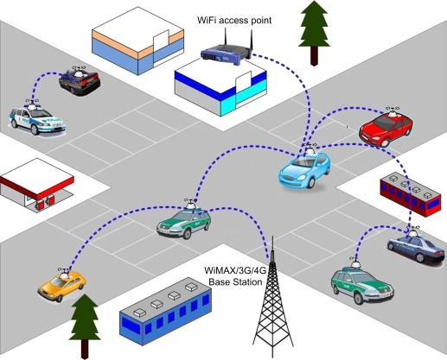
06
Vehicular ad hoc networks: This system uses wireless communication devices to provide services such as smart parking and anti theft.
Vehicular Ad-Hoc Networks
1
1
1
2
2
2
3
3
3
4
4
4
5
5
5
6
6
6
Notes:
Smart
Vehicular ad hoc networks: This system uses wireless communication devices to provide services such as smart parking and antitheft.
How to do :
Road side unites (RSUs) would be widely placed across parking lots and vehicles should be installed with on-board units (OBU).
A trusted authority will be responsible for registrations of OBU and RSUs
Therefore, once a vehicle approaches the parking lot installed with RSUs, navigational information to the vacant parking space will be provided to OBU.
Benefit : not sensitive to environment
Negative :
- installation and maintenance of RSUs in the parking lot would be expensive.
- All the vehicles must install OBU, if non-OBU vehicle is parked, accuracy of parking occupancy data and navigational information will be error

Slide 19
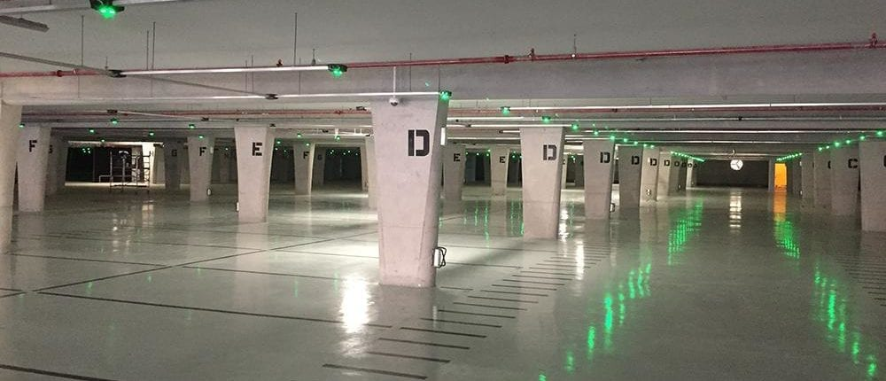
Visible Light Sensors
07
Visible light sensors measure the intensity of ambient light in the environment
1
1
1
2
2
2
3
3
3
4
4
4
5
5
5
6
6
6
Notes:
Smart
Visible light sensors measure the intensity of ambient light in the environment. To detect the occupancy of a parking space the sensor must be installed at a point where the light is obscured by a parked vehicle. This results in a reduced light intensity measured by the sensor, which is the basis for the detection of a parked vehicle.
Benefit : low installation and maintenance costs
Negative :
- Low Accuracy
- Easily afffected by environtment. vehicle detection by visible light sensing is easily influenced by the lighting conditions and any changes in the intensity of ambient light can result in detection errors.

Slide 20
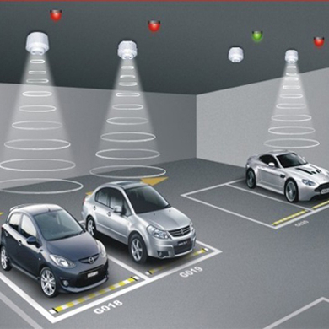
08
Ultrasonic sensors are active sensors that use sound waves to measure distance to an object.
Ultrasonic
1
1
1
2
2
2
3
3
3
4
4
4
5
5
5
6
6
6
Notes:
Smart
Ultrasonic sensor: These sensors would emit sound waves between 25 and 50 kHz and detect objects based on reflected energy.
Benefit :
- Based on the distance at which waves are reflected it can distinguish between a vehicle and a person
- Possibility of wireless installment
- Industrial-version claimed to have 99.9% accuracy
Negative :
- These sensors would be available for low cost (usually range from $20 to $100 per unit) but installation and maintenance of multiple sensors and connecting them to a grid would be expensive in the long run. Usually the placement is in celling as well, which added the cost
- Have moderate power consumption
- sensitive to environmental changes such as rain and snow
- Wireless usually prone of vulnerability
- Wireless involve periodic maintenance costs

Slide 21
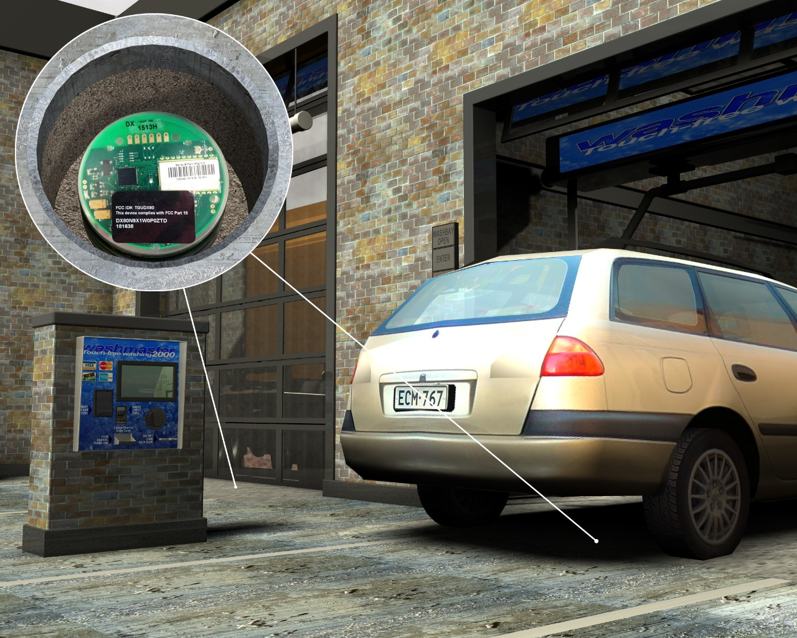
09
These sensors detect the presence of vehicle by detecting the change in electromagnetic field.
Magnetometer
1
1
1
2
2
2
3
3
3
4
4
4
5
5
5
6
6
6
Notes:
Smart Magnetometer: These sensors detect the presence of vehicle by detecting the change in electromagnetic field.
Installation : They need to be in close proximity to the vehicle, therefore, they are placed beneath the surface.
Benefit :
They are not sensitive to the environment
inexpensive, consume little power, and have a long battery life -> Relatively inexpensive and low maintenance for counting per unit
Negative :
Short Range
susceptibility to magnetic interferences
The sensors should be placed under every parking space to know the occupancy of parking spaces. However, it is expensive to install and maintain these sensors on a large scale.

Slide 22
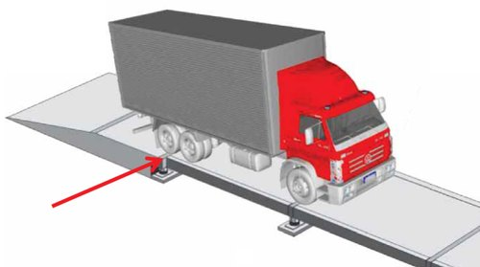

10
Load cell measures mechanical forces, mainly the weight of objects. It converts mechanical force into an electrical signal.
Load Cells
1
1
1
2
2
2
3
3
3
4
4
4
5
5
5
6
6
6
Notes:
Cindy Load Cell is a sensor, which converts mechanical force into an electrical signal

Slide 23
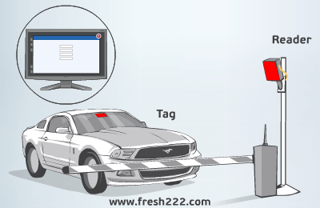
RFID, short for Radio Frequency Identification, is a technology for the transmission of small packets of data using radio waves. It consists of a tag and a reader.
11
RFID
1
1
1
2
2
2
3
3
3
4
4
4
5
5
5
6
6
6
Notes:
Cindy Radio-frequency identification (RFID): Radio frequency tags are used to identify vehicle.
How it works : Each vehicle will be given a radio frequency tag for identification. A transceiver and antenna would be installed at the entrance of a parking lot to identify the tag and allow the vehicle to occupy a parking lot
Benefit/Negative : RFID is used to authorise movement of vehicles at a parking lot.( However, it neither provides individual parking occupancy status nor facilitates the driver in finding a vacant parking space.)
Negative : - maintenance needs for both tags on the vehicles and readers in the parking spaces.
If there are no barrier to only allow RFID-installed vehicle to enter area, vehicle without or with broken RFID can mess up the vehicle counting and positioning data

Slide 24
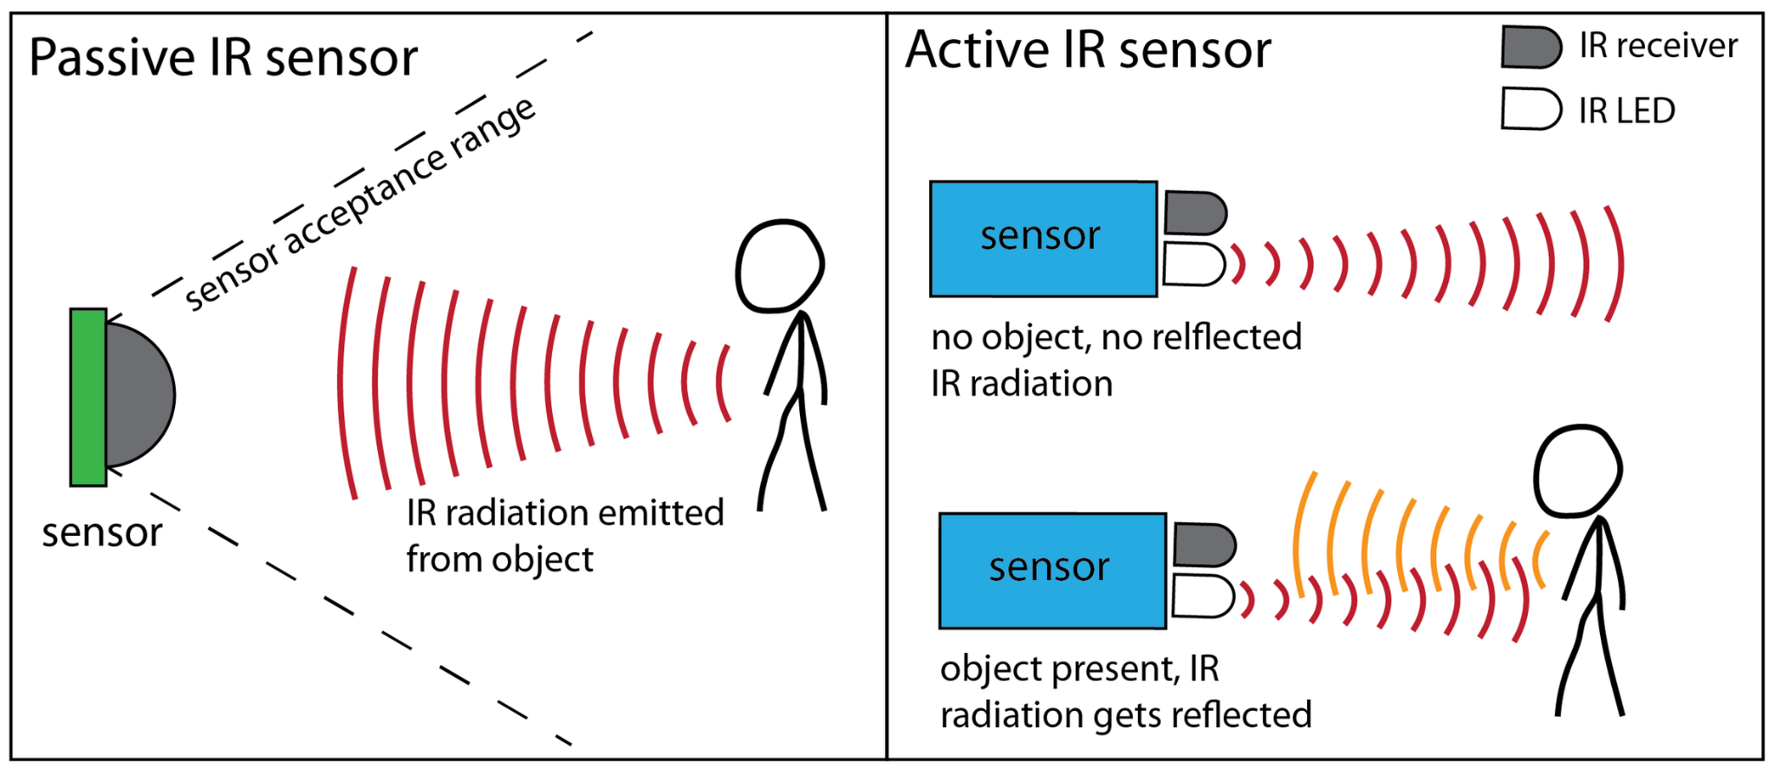
+
An infrared sensor (IR sensor) is a radiation-sensitive optoelectronic component with a spectral sensitivity in the infrared wavelength range 780 nm-50 µm.
The sensor elements detect the heat radiation (infrared radiation) that changes over time and space due to the movement of people.
ACTIVE
Active infrared sensors both emit and detect infrared radiation. Active IR sensors have two parts: a light emitting diode (LED) and a receiver. When an object comes close to the sensor, the infrared light from the LED reflects off of the object and is detected by the receiver.
Infrared
Passive & Active
12a
1
1
1
2
2
2
3
3
3
4
4
4
5
5
5
6
6
6
Notes:
Cindy Passive infrared sensor: These sensors detect changes in energy and when a vehicle occupies a parking space, these sensors identify the change in energy and detect occupancy
Negative :
- prone to interference by ambient light - sensitive to environment and they would not be accurate when there is snow or rain.
- require high investment for procurement and maintenance of these sensors, because should be placed under the ground or on the ceiling
- moderate power consumption
Active infrared sensor: These sensors would emit infrared energy and detect any object or vehicle by the amount of energy reflected
Negative : - sensitive to environment and they would not be accurate when there is snow or rain.
- require high investment for procurement and maintenance of these sensors, because usually placed on the ceiling Benefit : One of the most reliable under perfect environment (Eq. Indoor)

Slide 25
-
-
An infrared sensor (IR sensor) is a radiation-sensitive optoelectronic component with a spectral sensitivity in the infrared wavelength range 780 nm-50 µm.
The sensor elements detect the heat radiation (infrared radiation) that changes over time and space due to the movement of people.
PASSIVE
Passive infrared (PIR) sensors only detect infrared radiation and do not emit it from an LED.
PIR detection depend on natural radiations emitted from humans, animals, even inanimate objects — But how strong the radiation emitted is depend on many parameter, such as warmth.
Human can't see this radiation, but PIR sensor can.
Infrared
Passive & Active
12b
1
2
3
4
5
6
1
1
2
2
3
3
4
4
5
5
6
6
Notes:
Cindy Passive infrared sensor: These sensors detect changes in energy and when a vehicle occupies a parking space, these sensors identify the change in energy and detect occupancy
Negative :
- prone to interference by ambient light - sensitive to environment and they would not be accurate when there is snow or rain.
- require high investment for procurement and maintenance of these sensors, because should be placed under the ground or on the ceiling
- moderate power consumption
Active infrared sensor: These sensors would emit infrared energy and detect any object or vehicle by the amount of energy reflected
Negative : - sensitive to environment and they would not be accurate when there is snow or rain.
- require high investment for procurement and maintenance of these sensors, because usually placed on the ceiling Benefit : One of the most reliable under perfect environment (Eq. Indoor)

Slide 26
Inductive Loop Detector
13
Loops can detect a passing vehicle due to changes (of electromagnetism) in the emitted field and can provide information on time of detection and speed.
https://www.youtube.com/watch?v=DQfR7a1xctg
Vehicle Loop Detector(VLD)
1
1
2
2
3
3
4
4
5
5
6
6
Notes:
Cindy Inductive loop detectors: These detectors are installed using underground wiring system and they use principles of electromagnetism to detect the presence of a vehicle. This sensor commonly used at the entrance and exit to know the count of the vehicles which can be used to know the availability of parking spaces.
Negative : expensive to install and maintain
Benefit : An accurate count of vehicles would be provided (However, individual parking occupancy status cannot be attained using inductive loop detectors)

Slide 27
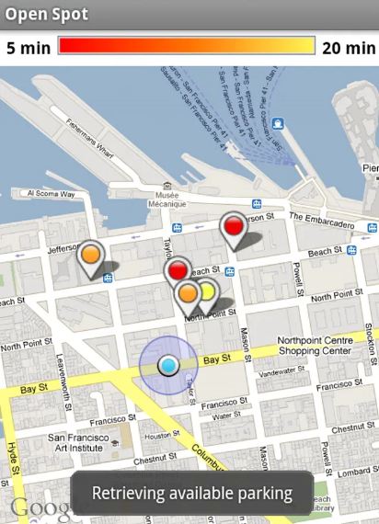
14
The practice of obtaining information or input by enlisting the services of a large number of people, either paid or unpaid.
Crowdsourcing
Example : Google OpenSpot
At the beginning of a trip, you use Open Spot to mark the parking space you are leaving as vacant by tapping the Mark a Spot button. Google's servers then store and display this open spot to all Open Spot users for up to 20 minutes. At the end of the trip, you pop back into the Open Spot app to view the parking spaces near you that have been reported vacant on the map.
1
1
1
2
2
2
3
3
3
4
4
4
5
5
5
6
6
6
Notes:
Cindy
Mobile-Sensor -> Crowdsourcing data collection is how occupancy data collected from users update. (Users update details of parking spaces every time they park the vehicle)
Benefit :
- suited for open/closed parking lots
- the expenditure is considered very minimal
- No hardware installations or maintenance is required.
Negative :
Calculation of parking time and accuracy of the information will be dependent on the user updating the occupancy details and is prone to human errors.
involves location sharing and raises privacy concerns.
users may choose not to share their information (free riders) or deliberately disseminate false information to keep other drivers away from particular parking spaces for their own benefit (selfish liars)

Slide 28
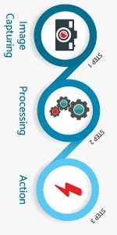
Machine vision (MV) is the technology and methods used to provide imaging-based automatic inspection and analysis
Machine Vision
15
1
1
2
2
3
3
4
4
5
5
6
6
Notes:
Cindy
Machine vision: A visual camera can be used for license plate recognition (LPR) or identifying parking lot occupancy using machine vision (powered with AI, Neural networks, image processing and deep learning).

Slide 29
SENSORS | Accuracy | Cost | Scalability | Reliability/ Environment Dependency | Installation/ Maintenance Difficulty
WCS | Moderate | Low | Moderate | Low | Difficult
GPS | Low | Low | High | Low | Low
Bluetooth Beacons | Low | Moderate | Moderate | Low | Moderate
Load Cells | High | High | Difficult | High | Difficult
Infrared (Passive) | Moderate | High | Difficult | Low | Difficult
Infrared (Active) | High | High | Difficult | Moderate-Low | Difficult
Ultrasonic | High | Extremely High | Extremely Difficult | High | Difficult
Inductive Loop Detector | Moderate | High | Extremely Difficult | Moderate | Extremely Difficult
Magnetometer | Low | Low | Difficult | Moderate | Extremely Difficult
RFID | High | Moderate | Extremely Difficult | Moderate | Difficult
Microwave Radar | Moderate | High | Extremely Difficult | High | Difficult
Contact Sensors | High | Low | Differ | High | Extremely Difficult
Vehicular ad-hoc networks | High | Extremely Difficult | Extremely Difficult | High | Extremely Difficult
Visible light sensors | Low | Low | Moderate | Low | Low
Crowdsourcing | Extremely Low | Low | Easy | Low | Low
Machine Vision | Moderate | Moderate | Easy | High | Moderate
Notes:
Cindy
Machine vision middle ground

Slide 30
Recommendation Machine Vision
Why we recommend it?
Environmental problem is solved 2. Cost effective 3. Easy maintenance 4. Multi purpose
Technology
3d Scene Information (Remove Shadow, Lightning, etc), AI, Neural Networks, Image Processing and Deep Learning
How it works?
Breaking video into frames (image) per N seconds, the image will be learned to decide LP, position, empty spot, burglary, etc
Challenges
Environmental and performances challenges have been SOLVED (3d scene information)!!
Conclusion
This is the most suitable technology solution according to our study case (outdoor parking lot)
1
1
2
2
3
3
4
4
5
5
6
6
Notes:
WCS mora stable, Ultrasonic/infrared sensitive environment, Magnetomater/microwave not sensitive but pricey, scalability Cindy
Benefit :
- can count of vacant parking spaces (Vehicle counter)
- can validate vehicles based on their license plate (LPR)
- limited number of cameras can cover large number of parking spaces, the expenditure is considered minimal.
Negative (and solution) :
- Heavy performance. Video processing of parking lot using a camera is not ideal as it requires continuous transfer of large bandwidths. (Therefore, a video should be broken into images at regular intervals and frame rates)
- susceptible to limitations such as occlusion and shadow effects, distortion and lighting (removed with the use of 3D scene information )
Why this one is the best ?
Ultrasonic and infrared sensors are sensitive to environmental conditions
magnetometers and microwave radar are not sensitive to environmental conditions but are expensive to install and maintain at open parking lots
Even if the prices of sensors come down there would still be expenditure involved with installation and maintenance activities which would make it expensive to use sensors in open parking lots. Therefore, sensors are not ideal for open parking lots as expenditure should be minimal.
As expenditure plays an important role in the choice of technology, it is found that machine vision, multi-agent systems, along with convolutional neural network are suitable to provide parking occupancy information.
How it works?
The parking occupancy detection using machine vision will vary between closed and open parking lots as there can be varying light conditions in an open outdoor parking lot. As mentioned earlier, challenges faced by low lighting and shadow conditions can be addressed. Therefore, machine vision using visual camera is one of the feasible smart parking technology for acquiring real-time parking occupancy information in open parking lots. Machine vision can be associated with convolutional neural networks and deep learning for efficient image classification. In the literature, neural networks are used mostly for LPR and there are limited studies which use convolutional neural networks for parking occupancy detection. However, image classification accuracy is high while using convolutional neural networks.
Large datasets are already available and additional data would facilitate in further improving image classification. Different technologies or image classification algorithms can be tested using PKLot which is publicly available outdoor parking lot images dataset.
Data collected using the visual camera would be processed using image classification algorithms or convolutional neural network to generate parking occupancy information.
Conclusion?
Machine vision is another technology which uses the visual camera to acquire real-time parking occupancy information on open parking lots due to its minimal expenditure. The usage of the visual camera is dependent on regulations supported by the country which needs to be considered prior. However, there is no single ideal technology suitable for parking occupancy detection. Based on the type of parking lot and size, a different combination of smart parking technologies and sensors can be used for efficient and financially viable parking occupancy detection

Slide 31
1
1
1
2
2
2
3
3
3
4
4
4
5
5
5
6
6
6
Notes:
Cindy
Additional features can be expected from camera

Slide 32
Where we are?
01
Why we take smart parking as the focus?
3 - 4
02
How Smart Parking Works?
5 - 6
03
IoT base on Outdoor parking space
7 - 11
Technologies in Smart Parking System
04
9 - 26
13 - 31
05
Challenges of Outdoor Smart Parking
33
06
Summary
34
Notes:
Mercy

Slide 33
Challenges of Outdoor Smart Parking
Lack of a comprehensive quantitative comparison and benchmarking of the accuracy and reliability of outdoor parking occupancy sensors.
RARE RESEARCH
?
Improper parking
HUMAN
recognition of different vehicle types can’t be provided by most technology
UNIFORMITY
1
1
2
2
3
3
4
4
5
5
6
6
Notes:
Mercy The first challenge is the lack of a comprehensive quantitative comparison and benchmarking of the accuracy and reliability of parking occupancy sensors. - Another challenge is the detection of improper parking - A third challenge is the recognition of different vehicle types, which can be useful for pricing or identification of improper/illegal parking

Slide 34
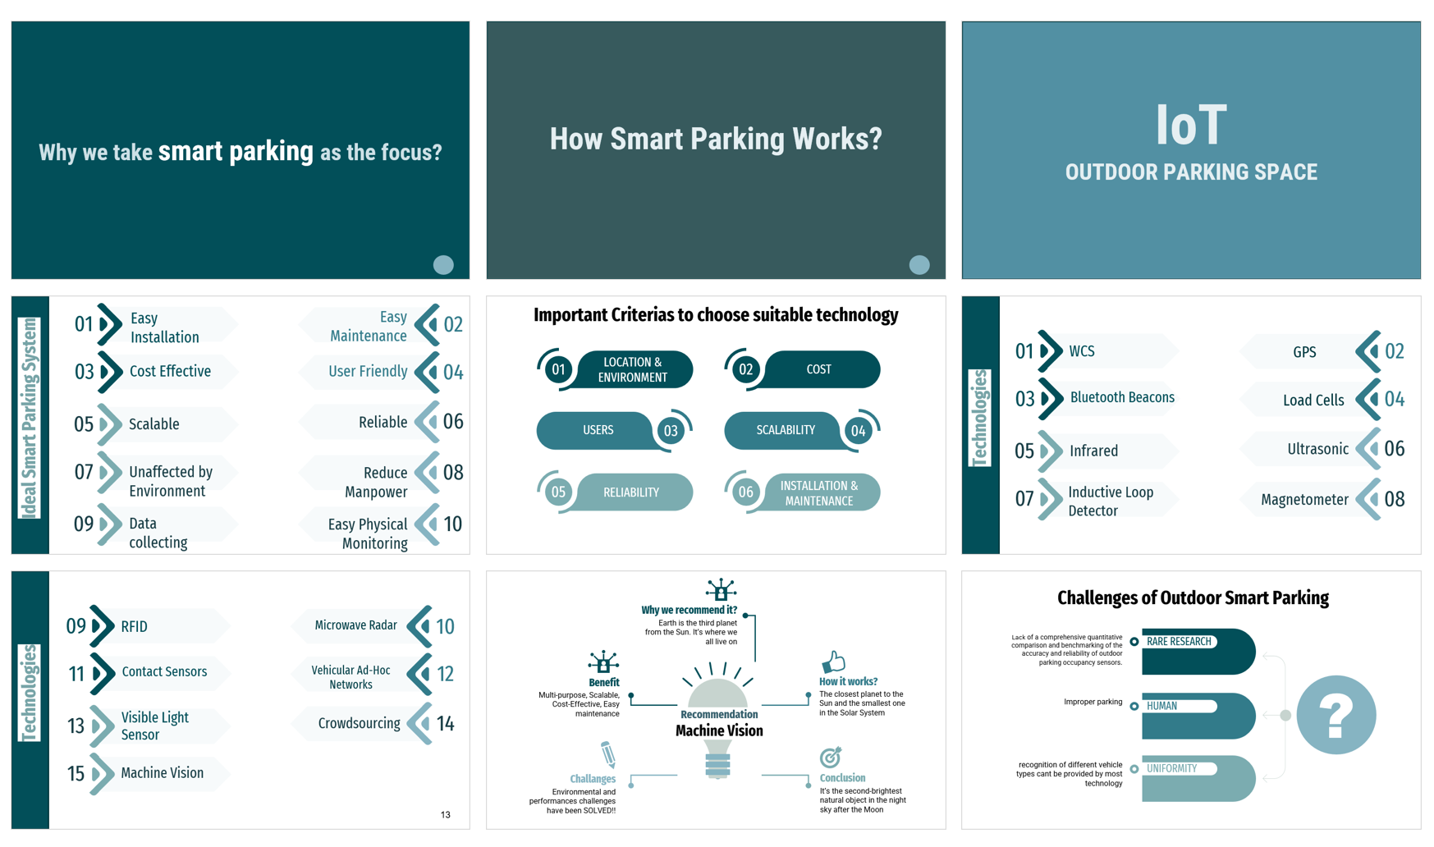
Notes:
Mercy

Slide 35
References
GokulKrishna, S. et al. (2021) “An IOT based Smart Outdoor Parking System,” 2021 7th International Conference on Advanced Computing and Communication Systems (ICACCS) [Preprint]. Available at: https://doi.org/10.1109/icaccs51430.2021.9441766.
Paidi, V. et al. (2018) “Smart parking tools suitability for open parking lots: A Review,” Proceedings of the 4th International Conference on Vehicle Technology and Intelligent Transport Systems [Preprint]. Available at: https://doi.org/10.5220/0006812006000609.
Winter, S. and Goel, S. (2021) “10,” in Smart parking in fast-growing cities;challenges and solutions. S.l.: TU WIEN ACADEMIC PRESS, pp. 132–142.

Slide 36
THANK YOU

